Slide 1

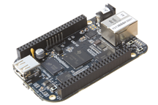

Introducing the $45, 1-GHz BeagleBone Black – Maker tested, engineer approved
BeagleBone Black
Open-source Linux computer
Everything you need to get started for $45
For hobbyists, engineers and students
Jason Kridner
Co-Founder
BeagleBoard.org
Under embargo until April 23, 10 a.m. EDT

Slide 2
BeagleBone Black – 1 GHz performance ready to use for $45
Truly flexible open hardware and software development platform
$45
BeagleBone Black
Ready to use: $45
1 GHz performance
On-board HDMI to connect directly to TVs and monitors
More and faster memory now with 512MB DDR3
On-board flash storage frees up the microSD card slot
Support for existing Cape plug-in boards
All you need is in the box
Proven ecosystem from prototype to product
BeagleBone Black – the best deal in open-source computing
Under embargo until April 23, 10 a.m. EDT
Notes:
A credit-card-sized Linux computer, BeagleBone Black is a truly flexible open hardware and software development platform
BeagleBone Black includes all the accessories to start developing, providing a lower total cost of ownership than the nearest competitor
BeagleBone Black builds on a proven ecosystem that speeds up development time for a project, product or prototype

Slide 3
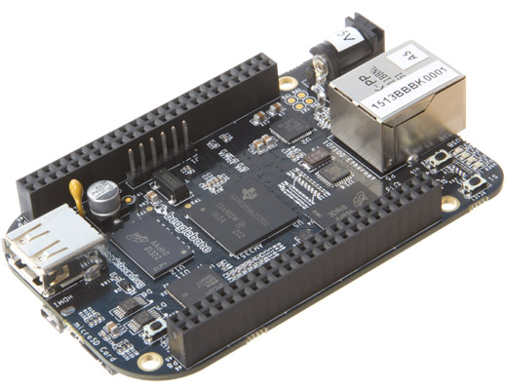
BeagleBone Black 1 GHz performance ready to use for $45
10/100 Ethernet
Power Button
DC Power
LEDS
USB Host
Serial Debug
Reset Button
Easily connects to almost any everyday device such as mouse or keyboard
USB Client
Development interface and directly powers board from PC
microHDMI
2GB on-board storage using eMMC
Pre-loaded with Ångström Linux Distribution
8-bit bus accelerates performance
Frees the microSD slot to be used for additional storage for a less expensive solution than SD cards
Connect directly to monitors and TVs
1 GHz Sitara AM335x ARM® Cortex™-A8 processor
Expansion headers
microSD
Expansion slot for additional storage
Enable cape hardware and include:
65 digital I/O
7 analog
4 serial
2 SPI
2 I2C
8 PWMs
4 timers
And much much more!
Provides a more advanced user interface and up to 150% better performance than ARM11
512MB DDR3
Faster, lower power RAM for enhanced user-friendly experience
Boot Button
Included in price:
Power supply ~ $10
USB network cable ~ $3
2GB on-board storage $5-$10
PRU for real-time tasks typically on FPGA ~ $20
Under embargo until April 23, 10 a.m. EDT
Notes:
Emphasize Sitara: It no longer appears later in this deck.
Expansion heads information will enable you to transition to capes slide.

Slide 4

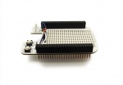
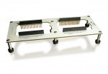
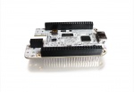
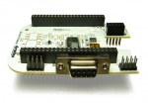
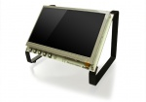
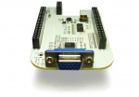
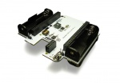
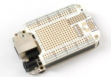
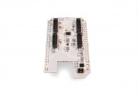
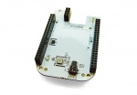
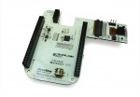
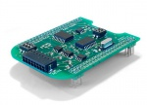
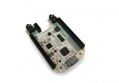
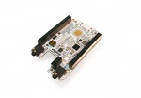
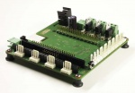
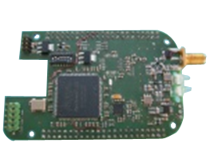
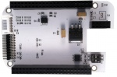
Capes easily expand BeagleBone capability
Breadboard
Breakout
LCD
DVI-D
CANBus
7”, 4.3” or 3.5”
RS232
RS485
VGA
Battery
Profibus
Proto
RF-CC1101
CC2500
CC2530
Weather
Camera
CAN
DVI-D w/Audio
Audio
BeBoPr 3D Printer
Radar
LVDS
Under embargo until April 23, 10 a.m. EDT
Notes:
http://circuitco.com/support/index.php?title=BeagleBone_Capes

Slide 5
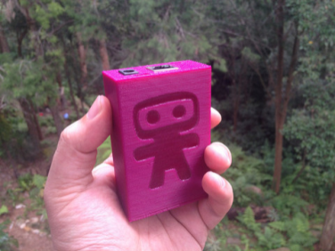
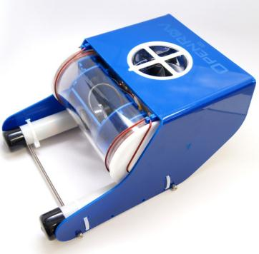

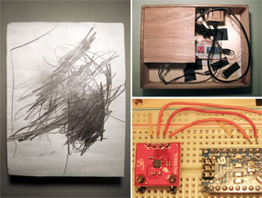
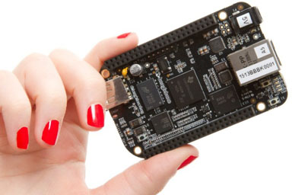

Easily transform ideas into usable, unique products
Engineers
Ninja block
OpenROV
Students
Electroacoustic drawing board
Hobbyists
Electronic light sculpture
Under embargo until April 23, 10 a.m. EDT

Slide 6
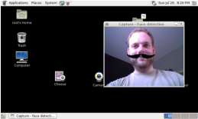
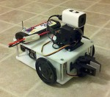
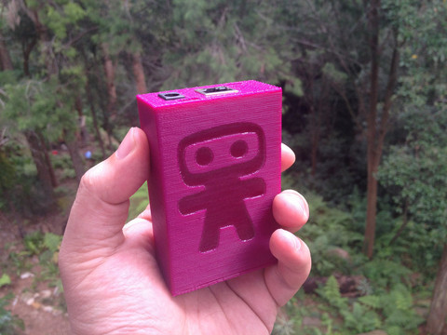
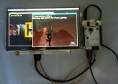
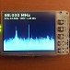
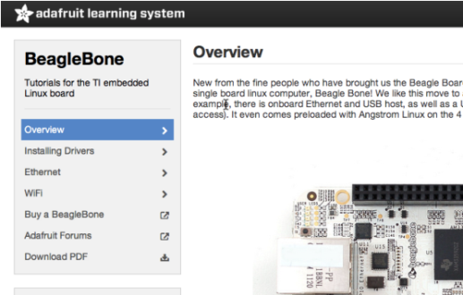
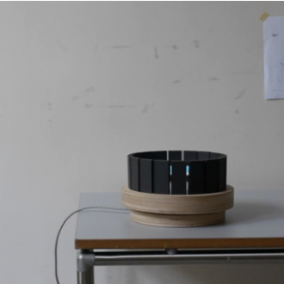
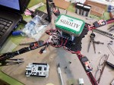
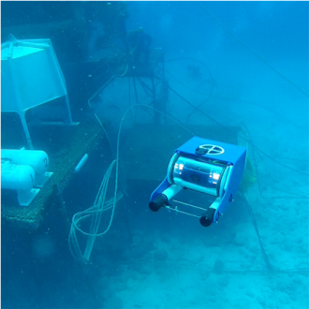
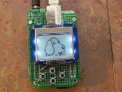
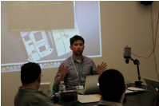
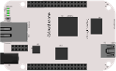
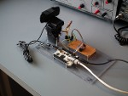

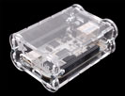
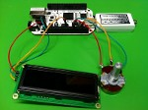
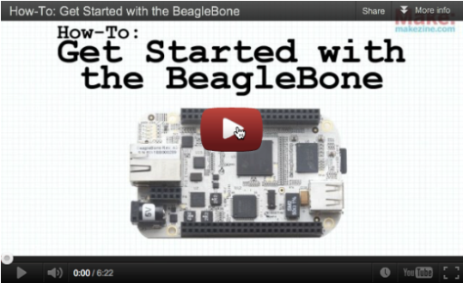
...and many more!
Under embargo until April 23, 10 a.m. EDT

Slide 7

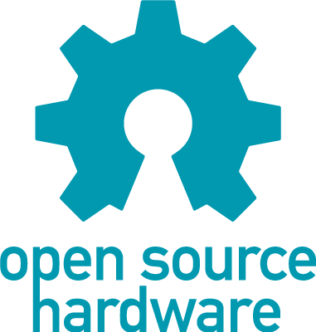

BeagleBone Black – truly open-source hardware and software
Development Unchained
You can get the chips, the docs and the software!
Open source gives people the freedom to control their technology while sharing knowledge and encouraging commerce through the open exchange of designs and code
Under embargo until April 23, 10 a.m. EDT
Notes:
Hardware design and software code is made publicly available so that anyone can study, modify, distribute, make, and sell the hardware design or software code.

Slide 8



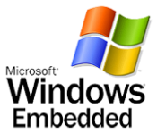




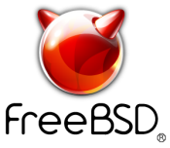







Endless software opportunities
OS
Flavors
Programming Language
Environments/ Libraries
C
C++
Cube
StarterWare™
More…
More…
More…
More…
Open industry development platform enabling a full range of software
Under embargo until April 23, 10 a.m. EDT

Slide 9
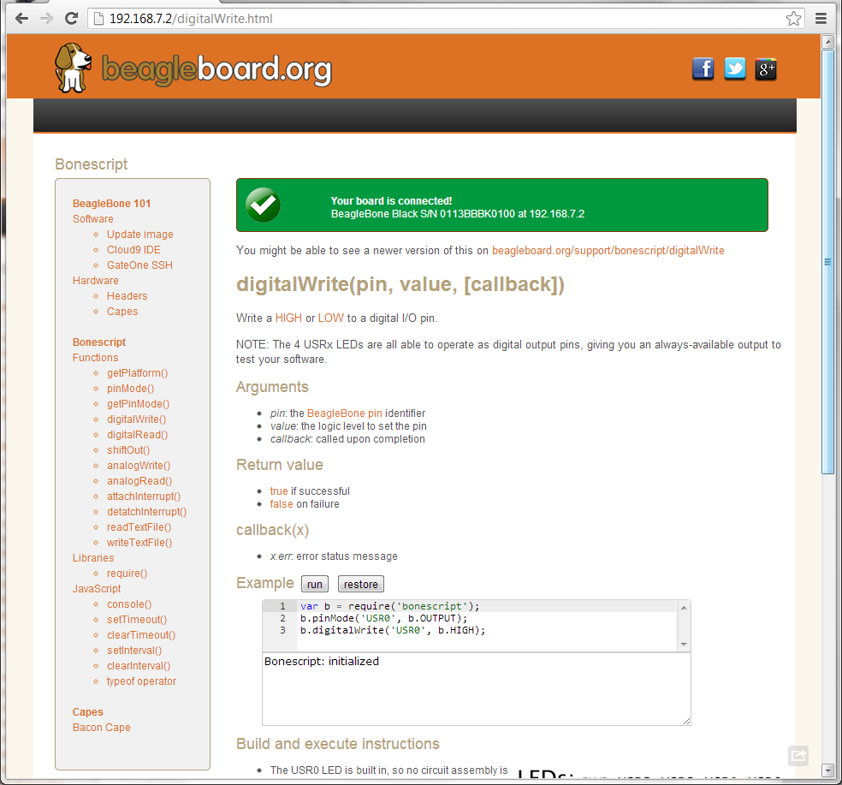
Bonescript: Arduino-like simplicity + the power of a 1GHz Linux computer
Browser-based interactive teaching environment
Zero-install
Runs directly on BeagleBone Black
Hides Linux complexity
Talks directly to the board
Programmatic interface into the board
Power of 1GHz computer on demand
Networking and USB stacks
Open-source frameworks available
Accessible keyboard/mouse/monitor
Accessible over SSH from PC
Built on familiar programming environments
JavaScript
HTML5
Node.js
Examples run directly in browser
Click to run
Editable in browser
Experiment to learn
Copy and paste
Bonescript
Arduino-like software for easy module interactions
Notes:
BoneScript enables physical computing exploration
Linux handles the interfaces, JavaScript provides the glue
Can code hardware as easily as you can code a web page
Interactively run and control the hardware through your browser
2x performance of Pi

Slide 10

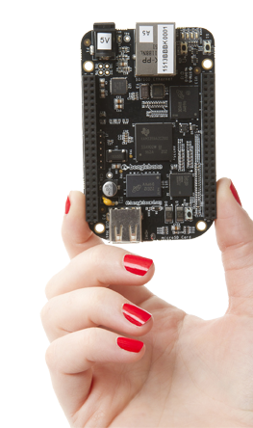
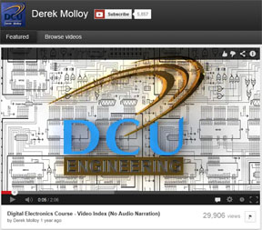
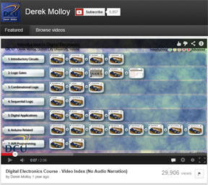

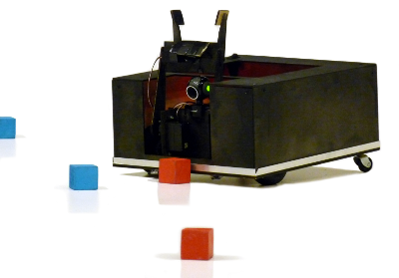
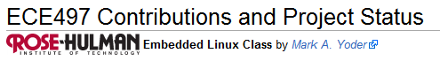
Changing the world through education and open source
demystifying technology
Bad to the Bone
BeagleBoard.org is a mentor helping students write code for open source projects
By Steven Barnett
Crafting Electronics Systems with BeagleBone and BeagleBone Black, includes tutorials
Derek Molloy video training series
Held at the University of Southampton, teams design, build and test their robots, and compete against other teams
Under embargo until April 23, 10 a.m. EDT
Notes:
https://developers.google.com/open-source/soc/
Google Summer of Code is a global program that offers post-secondary student developers ages 18 and older stipends to write code for various open source software projects. We have worked with open source, free software, and technology-related groups to identify and fund projects over a three month period. Since its inception in 2005, the program has brought together over 6,000 successful student participants and over 3,000 mentors from over 100 countries worldwide, all for the love of code. Through Google Summer of Code, accepted student applicants are paired with a mentor or mentors from the participating projects, thus gaining exposure to real-world software development scenarios and the opportunity for employment in areas related to their academic pursuits. In turn, the participating projects are able to more easily identify and bring in new developers. Best of all, more source code is created and released for the use and benefit of all.
https://www.studentrobotics.org/
Student Robotics is an exciting competition, held at the University of Southampton, between teams of students from sixth form schools and colleges, to build fully autonomous robots. Led by a group of students from the Universities of Southampton and Bristol, participating teams will have to design, build and test their robots, ready to compete against other teams.
http://www.youtube.com/user/DerekMolloyDCU

Slide 11
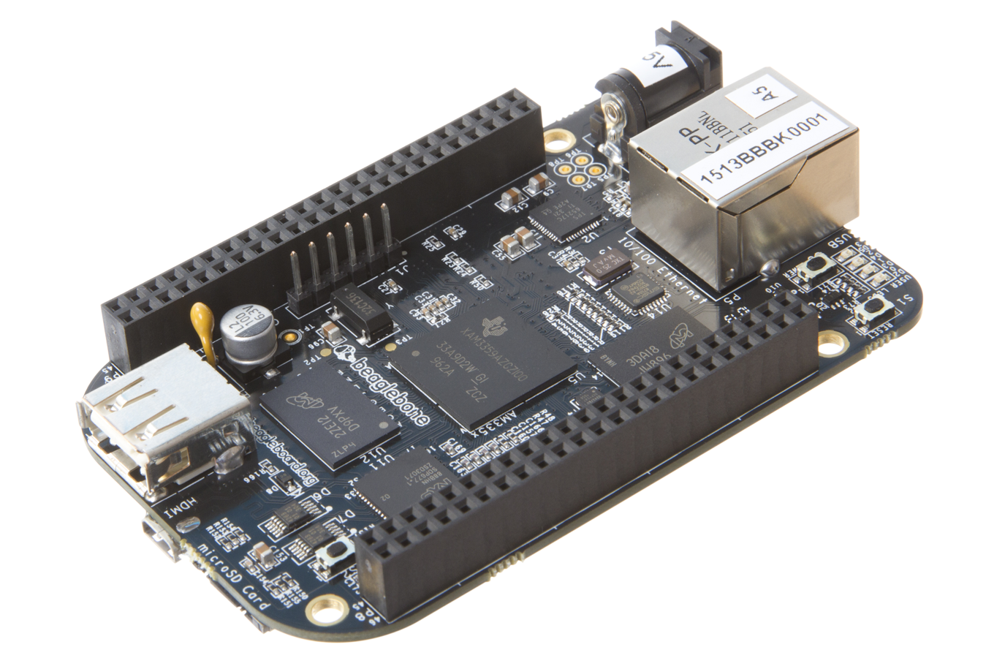
BeagleBone Black
Available on April 23 at
www.beagleboard.org/buy
Under embargo until April 23, 10 a.m. EDT
Notes:
Any questions?

Slide 12
Backup
Under embargo until April 23, 10 a.m. EDT

Slide 13

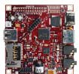



BeagleBone Black – an evolution
 | BeagleBoard | BeagleBoard-xM | BeagleBone | BeagleBone Black
Board
Quick summary | The original open hardware, ARM-based development board | All features of the original BeagleBoard with extra memory | Low-cost, open-source community platform with plug-in board expansion | Next-generation BeagleBone featuring 1-GHz processor
Memory | 256KB L2 cache | 512MB DDR2 | 256MB DDR2 | 512MB DDR3
Special features | 2D/3D graphics accelerator, HD video capable, USB powered | 1-GHz processing power, Four- port hub with 10/100 Ethernet | USB-powered, 10/100 Ethernet, USB JTAG | eMMC, onboard HDMI, USB, Ethernet and HDMI interfaces
Price ($U.S.) | $129 | $149 | $89 | $45
New
Under embargo until April 23, 10 a.m. EDT

Slide 14















How do you get it
beagleboard.org/buy

